Slide 1
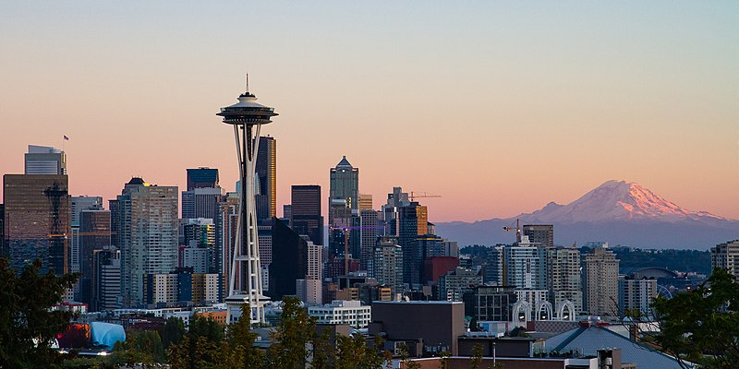
IBM Applied Data Science Capstone
Week #5 – Research Paper
“Opening a New Poke Restaurant in the City of Seattle”
By: Matt Pierce
January 2021
https://commons.wikimedia.org/wiki/File:Seattle_Kerry_Park_Skyline.jpg

Slide 2
1. Business Problem
Objective: Find best location in Seattle to open new Poke restaurant
Hypothetical Client: Existing Owner, wants to expand from 1 to 2
Target Requirements:
Clustered near other restaurants (e.g.: Game Theory of Gas Stations)
No existing Poke place nearby
Timely, need answer within 2 weeks
Be sure to include assumptions, errors, and omissions at Discussion section

Slide 3
2. Data Acquisition
Data Needs:
List of neighborhoods, zip codes and corresponding geo-coordinates
Demographic metrics tied to the zip codes and/or neighborhoods
Venue data such as nearby restaurants, competitors, like ratings, etc.
Data Sources:
City of Seattle OpenData Urban Centers list (online, neighborhoods)
AgingKingCounty.org PDF that cross-walks neighborhoods to zip codes
OpenDataSoft.com ties zip codes to geo-coordinates (latitude/longitude)
Python Geocode package to fetch geo-coordinates from addresses in a pinch
FourSquare API for nearby venue information

Slide 4
3. Methodology
Data Loading: Primarily CSV preparation, then used Pandas read_csv
Data Cleaning: Significant. Removed null value rows, de-duped and rolled up values to zipcode level, calculated aggregates, calculated population densities and rental percentages, combined multiple sources into single flat table grouped on zip code with neighborhoods aggregated into comma delimited list, validated results at checkpoint
Data Exploration: Significant. Explored base data via Folium map. Configured FourSquare API + loaded venue data.
Feature Selection: Wrote two scrubs to filter and simplify venue categories to restaurant related venues.
Modeling: Performed K-Means clustering to find patterns in locations
Visualize: Clusters in Folium map

Slide 5
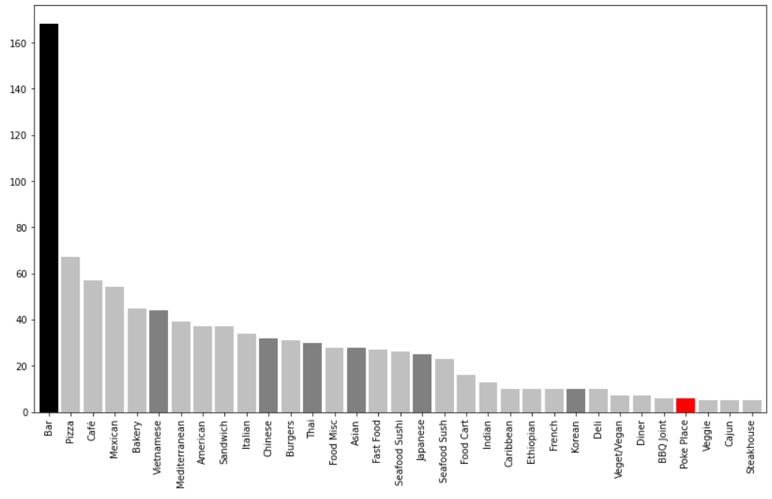
4.A Results, Macro
There is ample room for growth of Poke restaurants in Seattle
# Venues

Slide 6
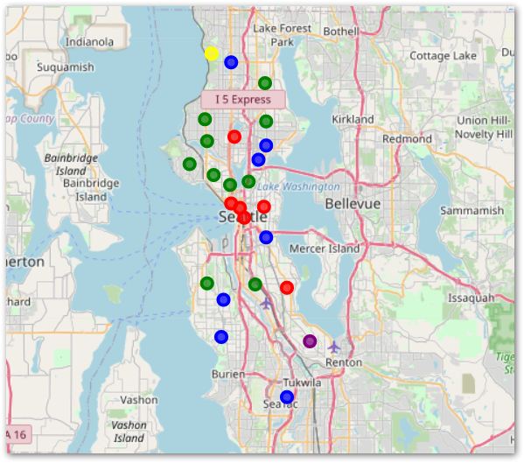
4.B Results, Modeling
Cluster #2 – Green = Target Locations
10 zip codes, no Poke competition yet
Cluster #4 – Blue = Possible Target Zones
7 zip codes, no Poke competition
Cluster #1 – Red = Avoid / Saturated
6 zip codes – ALL have Poke competition
Clusters #3/#5 – Yellow/Purple = Outlier
2 zip codes (one per cluster) = bad
No Poke competition…but few venues either

Slide 7
5. Discussion
Recommendations:
Yes, there is ample upside potential still in Seattle for opening a Poke restaurant
Focus on Cluster #2 primarily but also #4 because little to no competition yet
Avoid Cluster #1 as it is over saturated already with Poke competition
Avoid outlier Clusters #3 and #5 – there’s probably no market there
Suggest zip codes 98122 (Capital Hill), 98103 (Fremont), and 98121 (Bellltown)
Areas of Improvement:
More rigor w/demographics: factor rental rate, median income into clustering
Add in bus stations, don’t remove them
FourSquare radius 20 blocks = possible gaps, increase radius and dedup venues

Slide 8
6. Conclusions
Business Question = Answered
Yes, it is a good idea to open a second Poke restaurant
Suggested Locations = in or around zip codes…
98122 (Capital Hill)
98103 (Fremont)
98121 (Bellltown)

Slide 9
Thank You!
Taken from Sample Presentation that were part of course instructions – I liked this

